Slide 1
Enhance your Governance with the CoE Starter Kit
Marc Schweigert

Slide 2
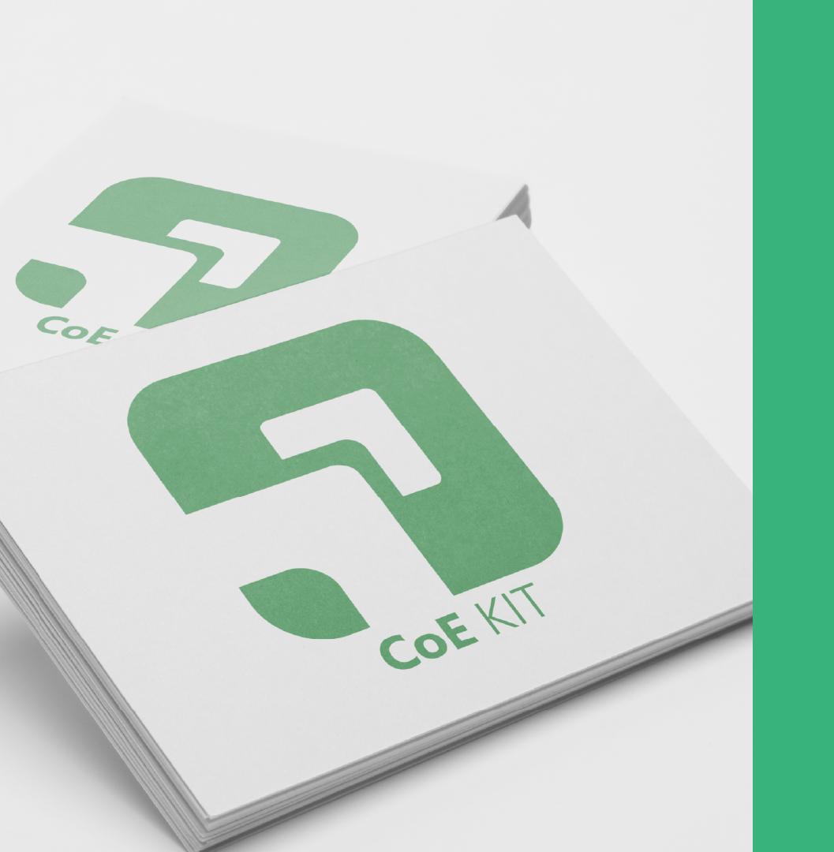
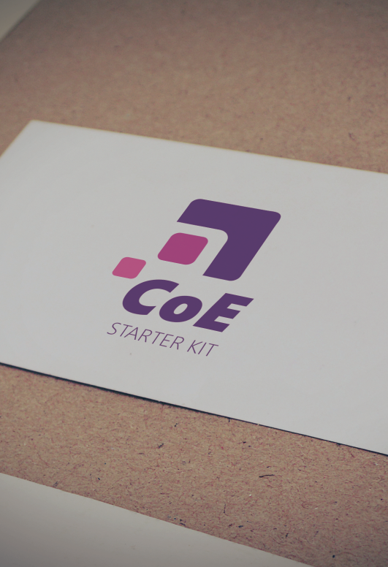
Power CAT Tools – Approach and Principles
Publish open-source reference implementations (aka kits) to help unblock immediate customer need
Built using Power Platform products – serve as best-in-class usage of the platform
Real-world usage of kits provides strong signal for prioritization of product features
Product teams incorporate most used capabilities into product roadmap
https://aka.ms/whoispowercat

Slide 3
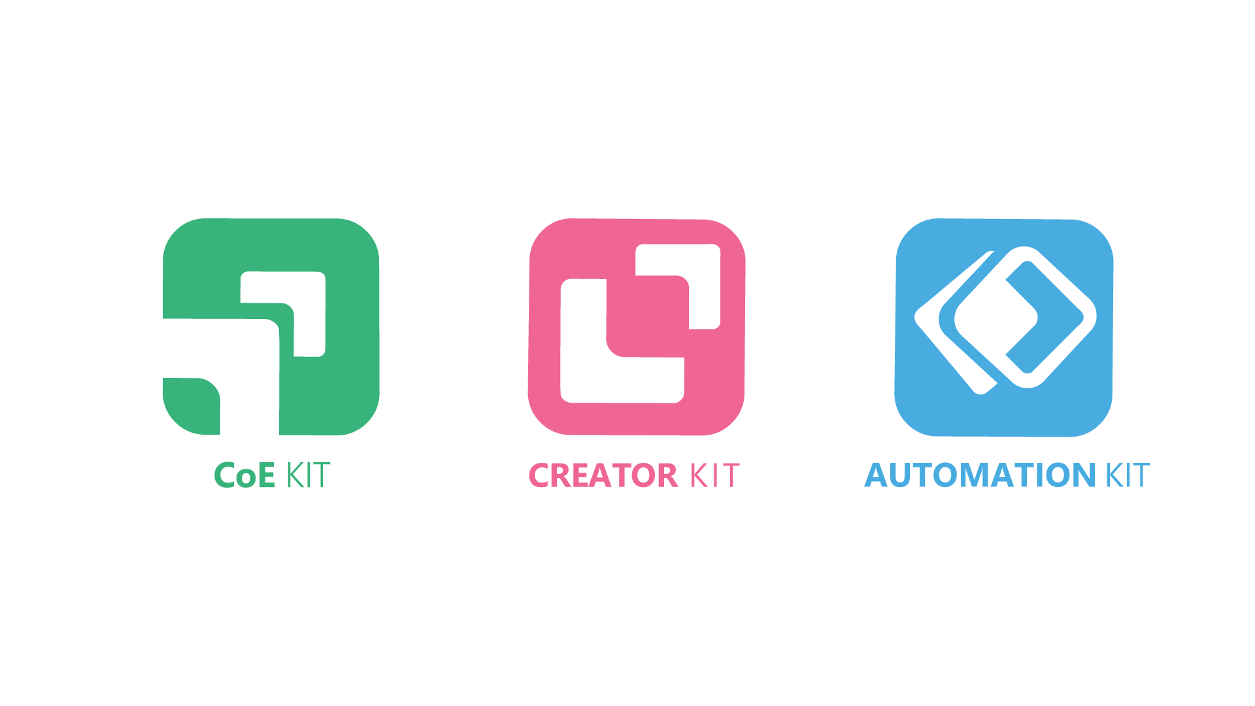

(+ALM Accelerator, Dataverse Accelerator, Power Apps Code Review Tool)
https://aka.ms/whoispowercat

Slide 4
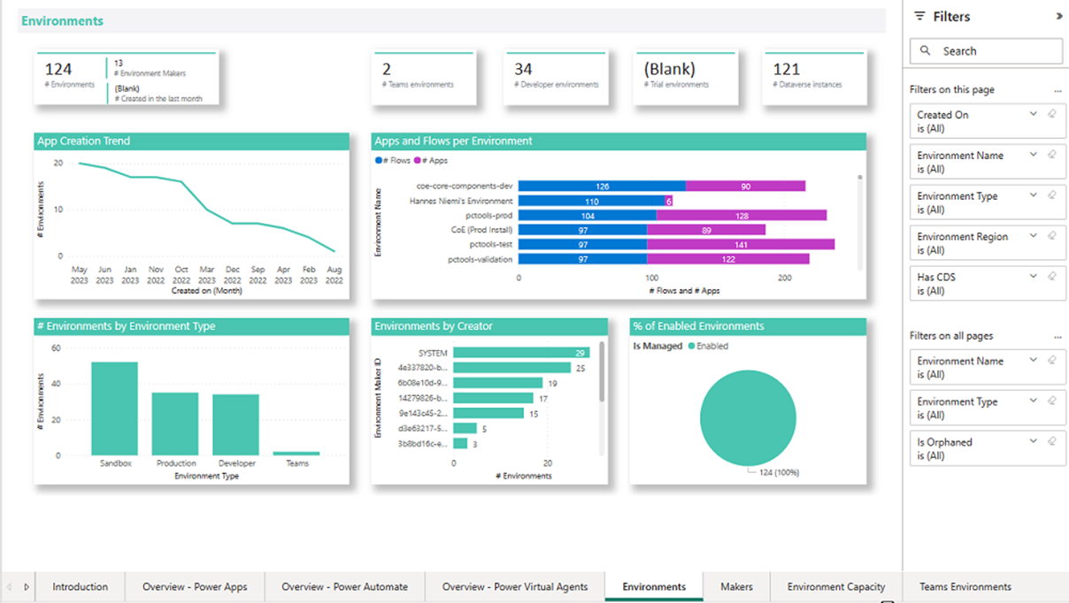
What is the CoE Starter Kit?
WHAT:
A reference implementation of proven practices designed to give you a starting point when adopting, governing and nurturing Microsoft Power Platform
Representative of what we have learned from customers
Innovation and experimentation
Implemented in an open-source low code model
WHY:
Learn from some of the largest organizations implementing Power Platform.
Provide signals on what matter most to you to influence the future product roadmap
LEARN MORE:
https://aka.ms/coestarterkit

Slide 5
Better Together
Managed Environments
Out of the box governance capabilities to manage the Power Platform at scale with more visibility, more control and less effort.
CoE Starter Kit
An open-source low code reference implementation of proven practices to get started, accelerate and nurture your Power Platform Adoption, based on years of customers experiences and feedback
https://aka.ms/MEGuidance
https://aka.ms/coeskme
Getting Started: Start with the out of the box Power Platform Admin Center and Managed Environments.
Explore the CoE Starter Kit and adopt workflows and insights to augment your governance strategy
On Going: Follow what’s new in Managed Environments, and what innovations have been added to the COE Starter Kit (Influence by joining https://aka.ms/coeofficehours). Extend your toolbox with homegrown or 3rd party solutions where needed.

Slide 6
How to use the CoE Starter Kit alongside the product?
CoE Starter Kit
Managed Environments
Power Platform Admin Center
Custom tooling
Start with the out of the box capabilities in Power Platform admin center and Managed Environments.
Those capabilities are robust in the product and fully supported.
And if you discover you need more capabilities to govern your tenant, see if features in the CoE Starter Kit can complement what you get out of the box.
If that still doesn’t meet your requirements, explore extending and customizing the CoE Starter Kit or building your own tooling from scratch.

Slide 7
Let’s look at some features of the CoE Starter Kit

Slide 8



Personas that play a role in your Power Platform Adoption
Victor
Admin
Victor works for Contoso, he is part of the Power Platform Administrators and often handles requests from businesses related to Governance & Compliance
Cameron
Anne
Maker
Cameron has been working for Contoso for 4 years. She needs to run an effective and efficient team and often she relies on Automation and Power Apps to digitally transform the organization.
Everyone
Anne will represent anyone in the organization, normally the App users within different roles

Slide 9



Admin / CoE Lead
Maker
Everyone
Get a holistic overview inventory, telemetry and makers in your tenant
Request environments and DLP policy changes instead of sending emails
Submit and describe the value of ideas that need building
Gain awareness of highly used and inactive resources
Build solutions faster through using templates, components or working with other makers
Start attending training events to become a maker yourself
Reduce manual effort by automating processes to deal with overshared, inactive and abandoned resources
Easily follow governance and compliance processes implemented by your admin
Apps
Flows
Bots
Environments
Makers
Power Platform Users and Roles
Usage
Connectors
Power Platform Inventory, Telemetry + Organisation Data

Slide 10
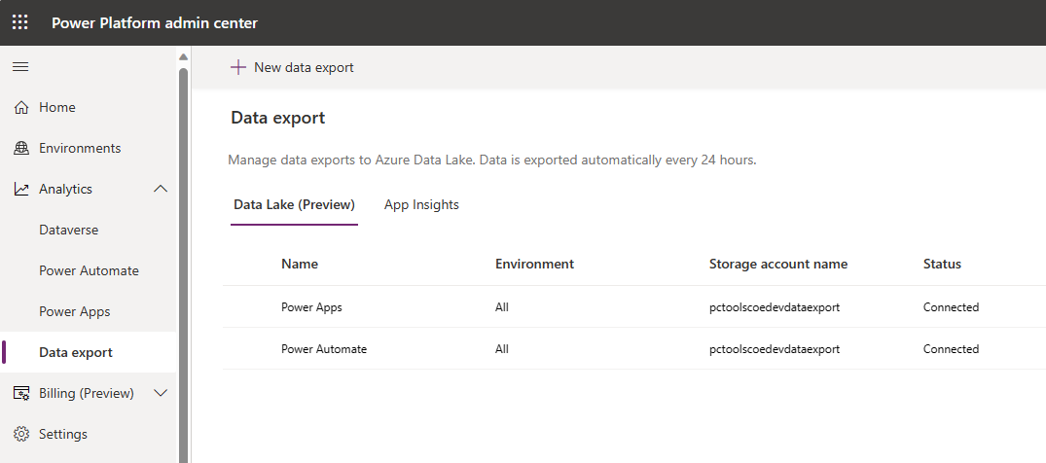
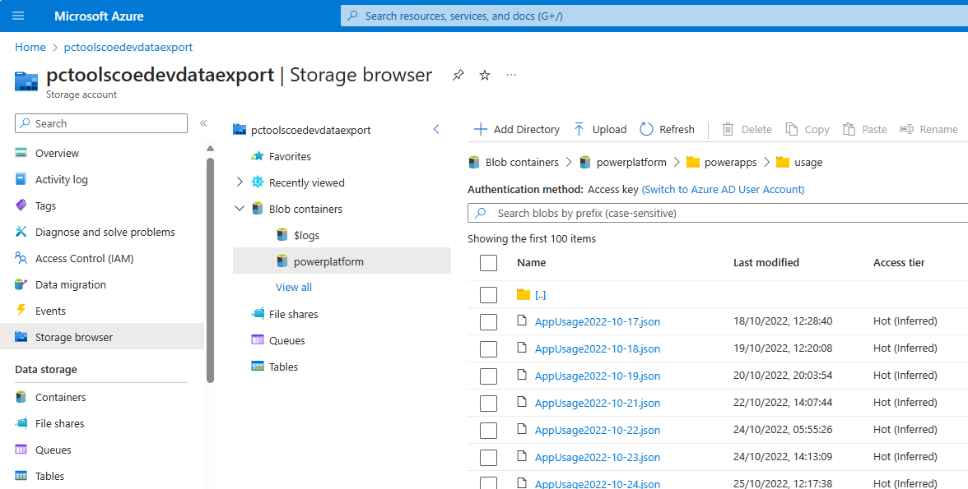
Increased scalability via inventory/usage export
Public Preview
Apps
Flows
Bots
Environments
Makers
Usage
Connectors
Power Platform Inventory, Telemetry + Organisation Data

Slide 11
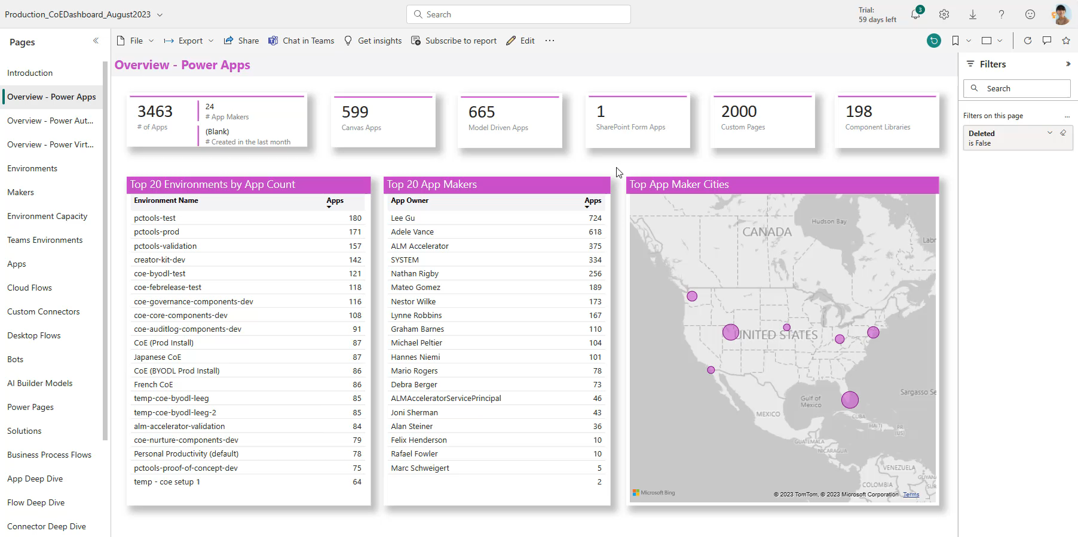

Power BI dashboards
Act on insights
Data Policy Impact analysis
As a Microsoft Power Platform admin, Victor wants visibility into how Contoso is using Power Apps and Power Automate. Insights into the adoption will help him govern and secure the platform, identify patterns, and enable him to nurture makers to accelerate adoption and value.
Victor
Admin

Slide 12
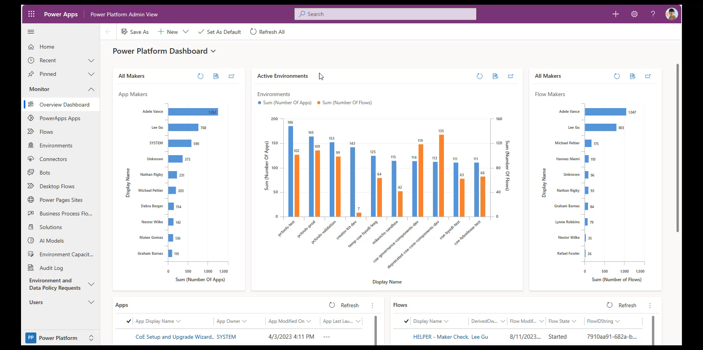
Power BI dashboards
Act on insights
Data Policy Impact analysis
As a Microsoft Power Platform admin, Victor wants to browse Power Platform inventory and immediately take action based on his findings – such as quarantining apps, deleting resources, managing permissions or emailing the maker. He can use the Power Platform Admin View to achieve this.
Victor
Admin

Slide 13
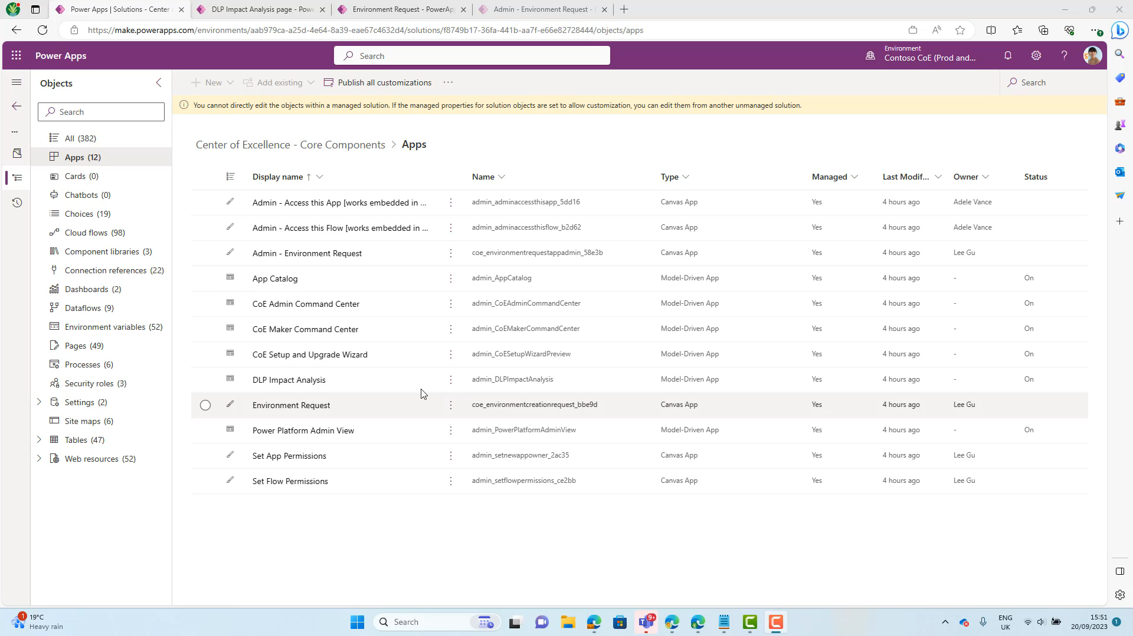
Power BI dashboards
Act on insights
Data Policy Impact analysis
As a Microsoft Power Platform admin, Victor wants apply Data Policies to existing environments without causing an impact and breaking existing apps and flows.
Victor
Admin

Slide 14
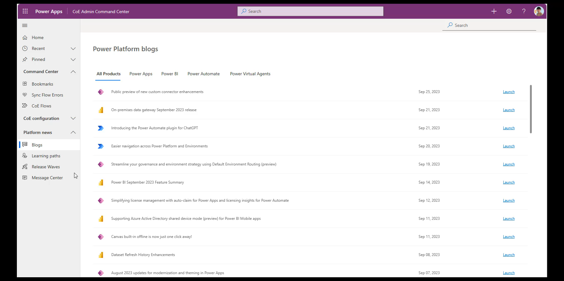
Power BI dashboards
Act on insights
Stay up to date
Bulk update permissions
As a Microsoft Power Platform admin, Victor wants to gather compliance and support details from makers to better understand the apps, flows, bots,… that are being built and identify if additional resources are needed to better support those apps.
Victor
Admin

Slide 15
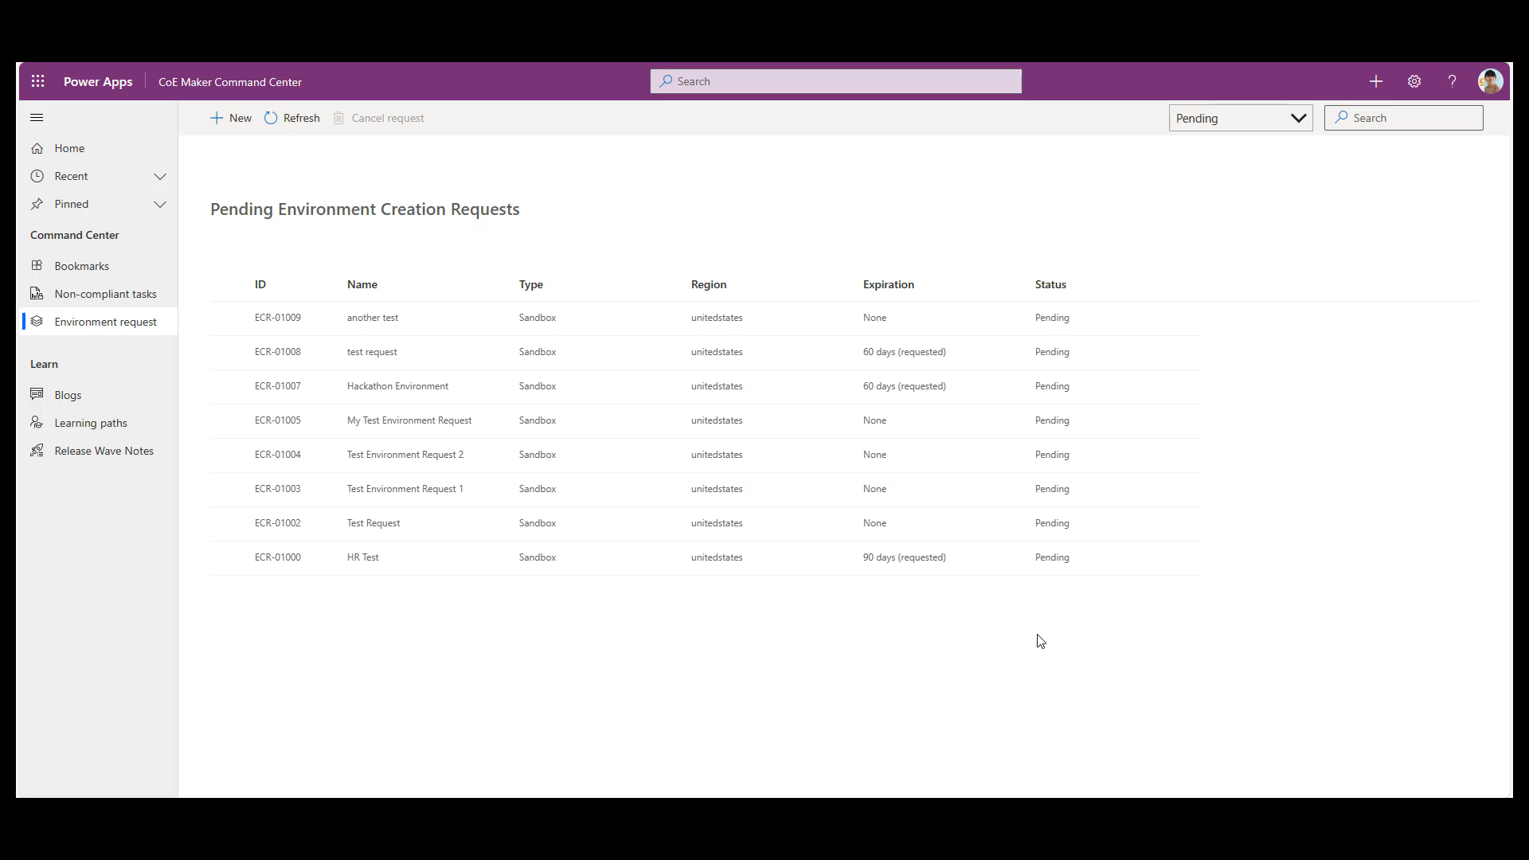
Demo

Slide 16
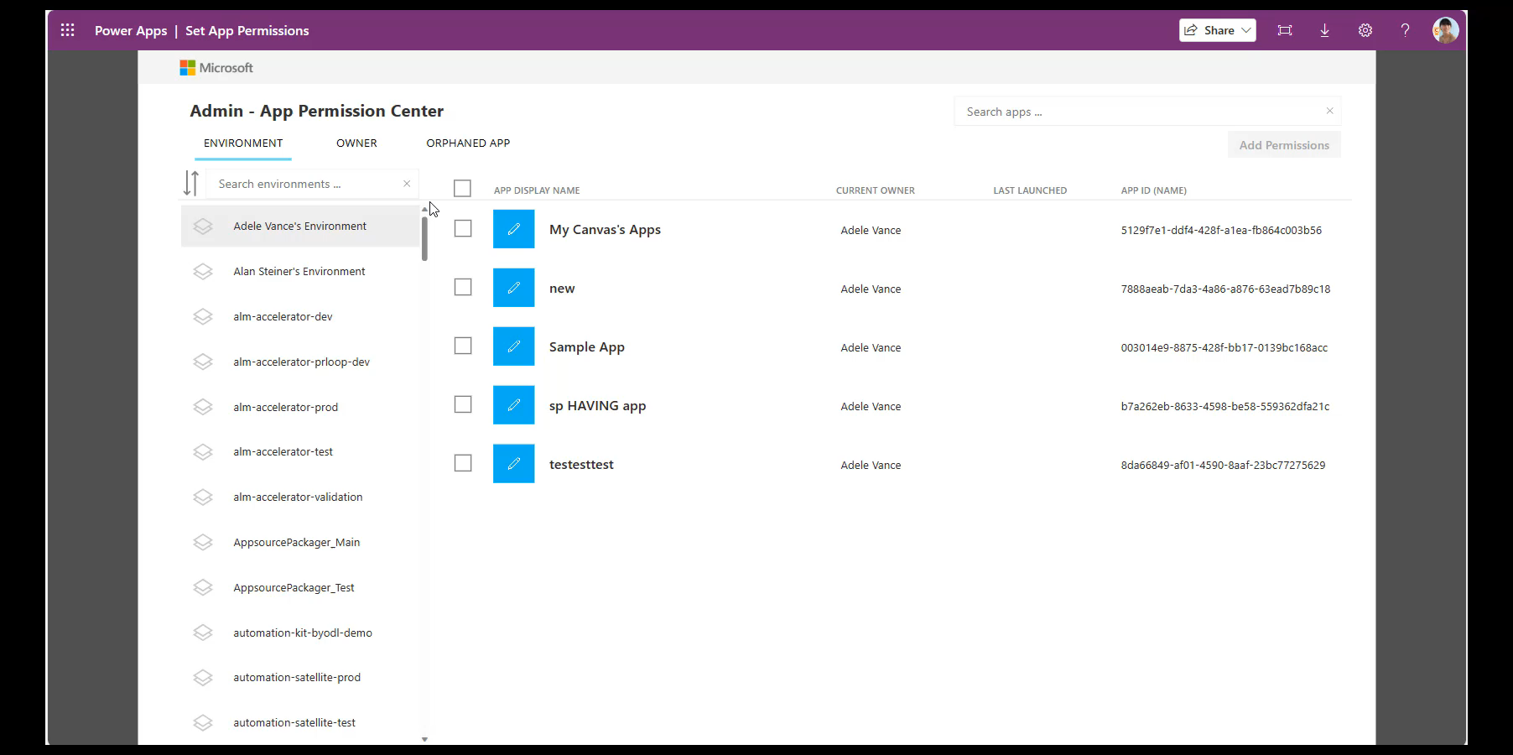
Power BI dashboards
Act on insights
Stay up to date
Bulk update permissions
As a Microsoft Power Platform admin, Victor wants to bulk update app and flow permissions – for example, to change ownership to a service account or move all apps of a maker to a new owner.
Victor
Admin

Slide 17
Environment Request
Compliance Process
Cameron
Cameron is excited about working with Power Platform – however, there’s so much information out there both internally and externally, it can be a little hard to stay up to date. She uses the Maker Command Center to browse bookmarks her admins are sharing and learn blog posts and learning paths.
Maker

Slide 18
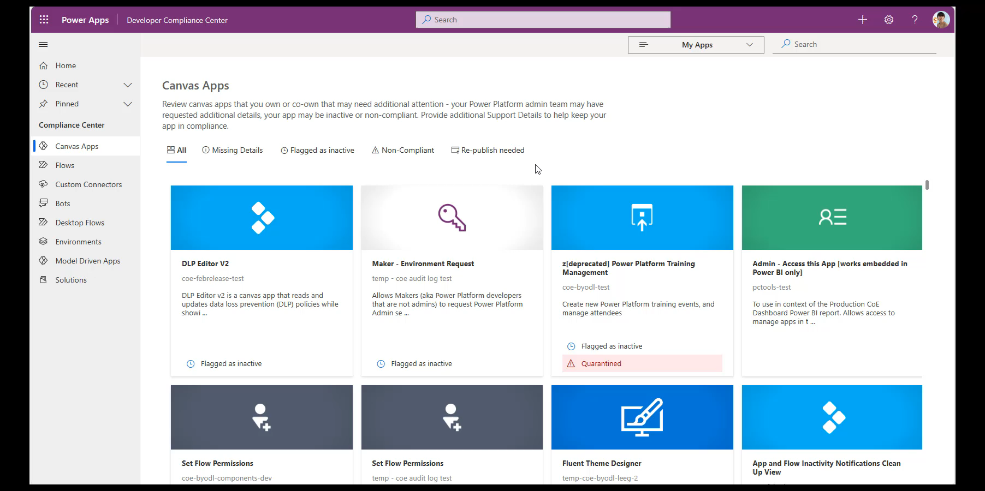
Stay up to date
Compliance process
Cameron
One of Cameron’s early apps is in the Default environment and has recently increased in usage – an automated process prompts her to provide a business justification and mitigation plan for this app for Victor to review. Based on this information, Victor can then suggest the best ALM and support process for this app.
Maker

Slide 19
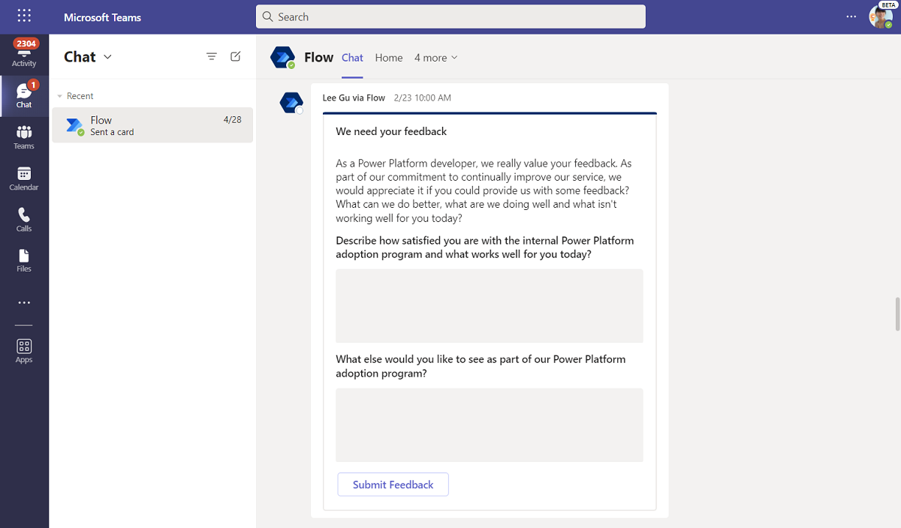
Stay up to date
Compliance process
Pulse feedback
Solution assessment
Cameron
Viktor has implemented Power Platform governance and nurture processes – and is keen to find out what works’ and doesn’t work for the makers in the organization. The Pulse feedback prompts makers to provide feedback on the Power Platform adoption strategy, and Viktor can use a dashboard to analyze the feedback provided.
Maker

Slide 20
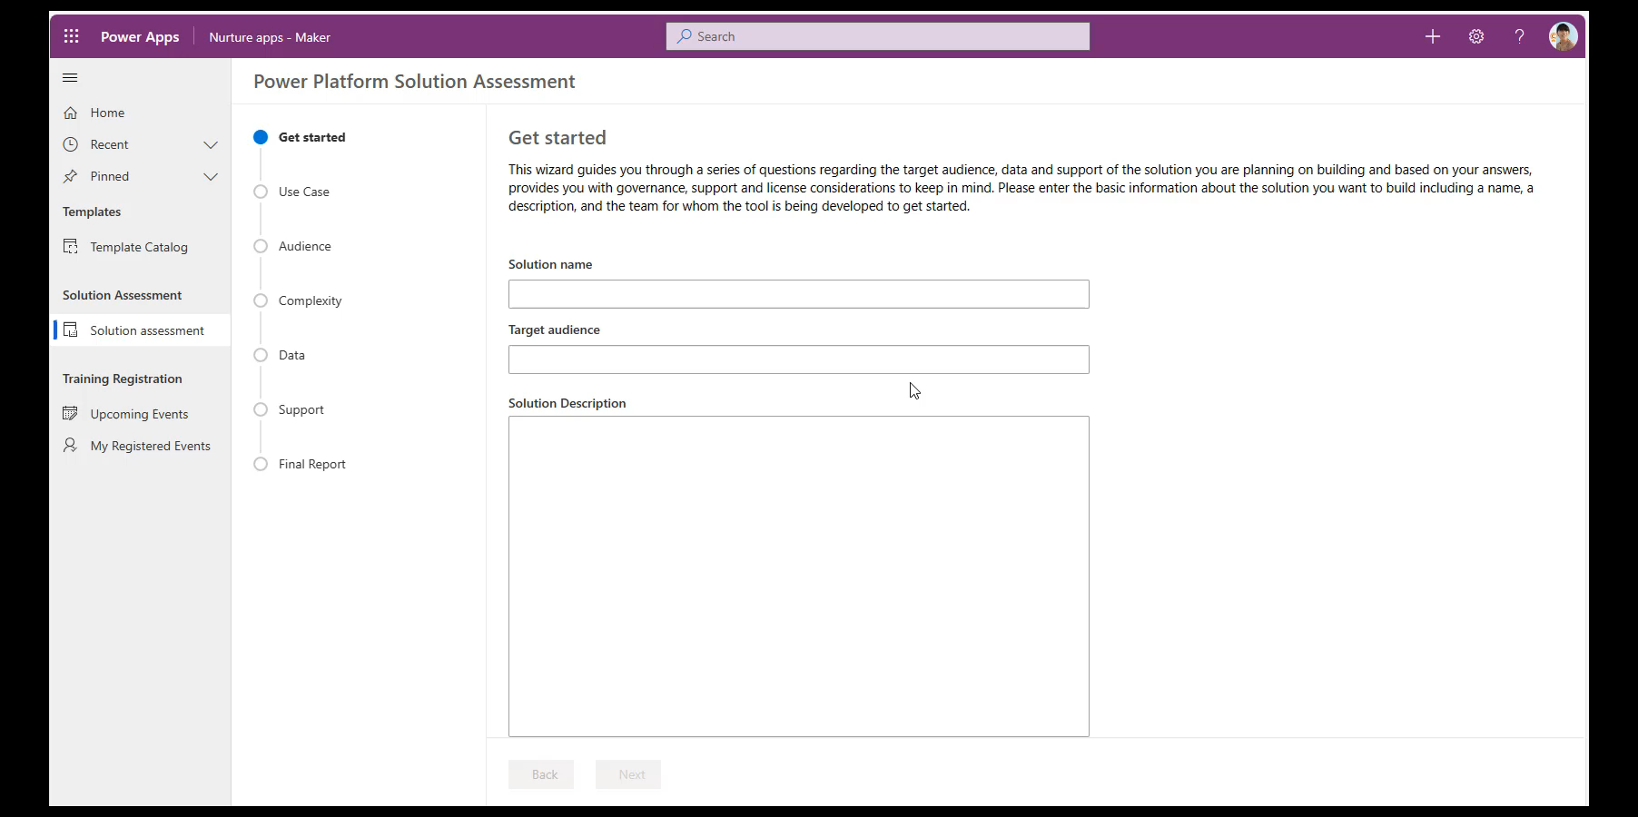
Stay up to date
Compliance process
Pulse feedback
Solution assessment
Cameron
Cameron has an idea for a new app that she wants to build. She wants to make sure she follows all the guidelines and takes additional costs into consideration. She uses the Solution assessment tool to walk through her scenario and receive additional guidance prepared by Viktor.
Maker

Slide 21
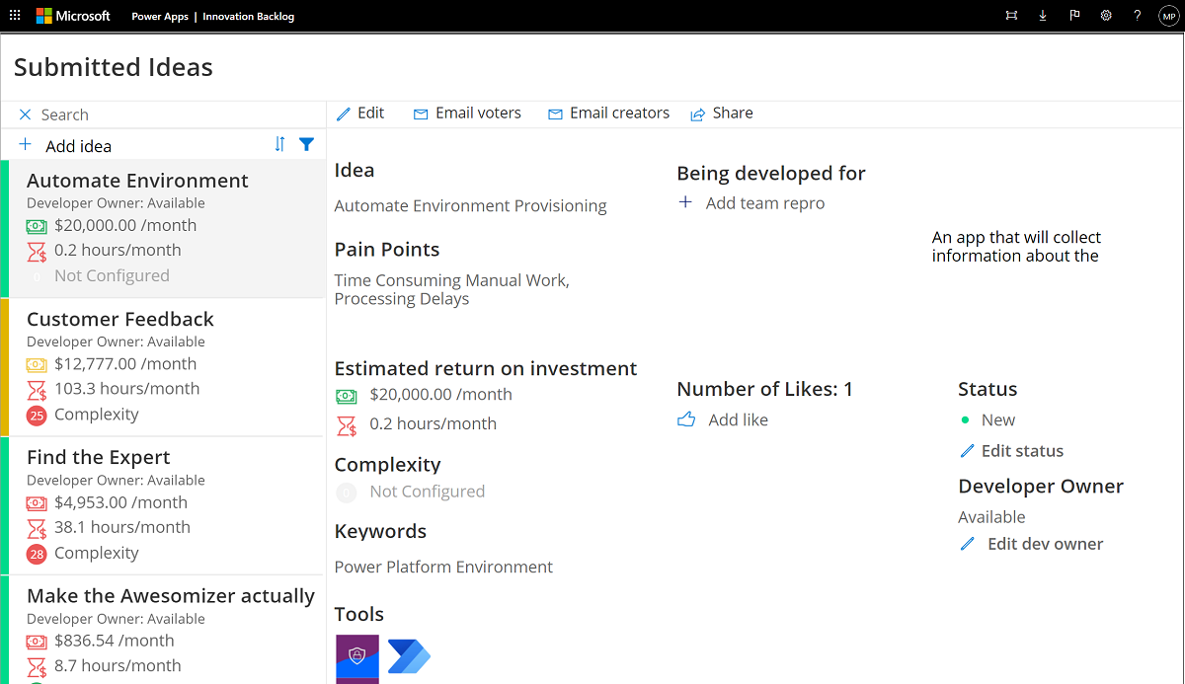

Innovation Backlog
App catalog
Video hub
Anne
Anne is using a lot of apps and flows that her colleagues have built, and she has many ideas for further processes that could be digitized and automated – if only she had time to develop them! Instead, she submits them and their value in the Innovation Backlog and hopes an existing maker can help her out.
Everyone

Slide 22
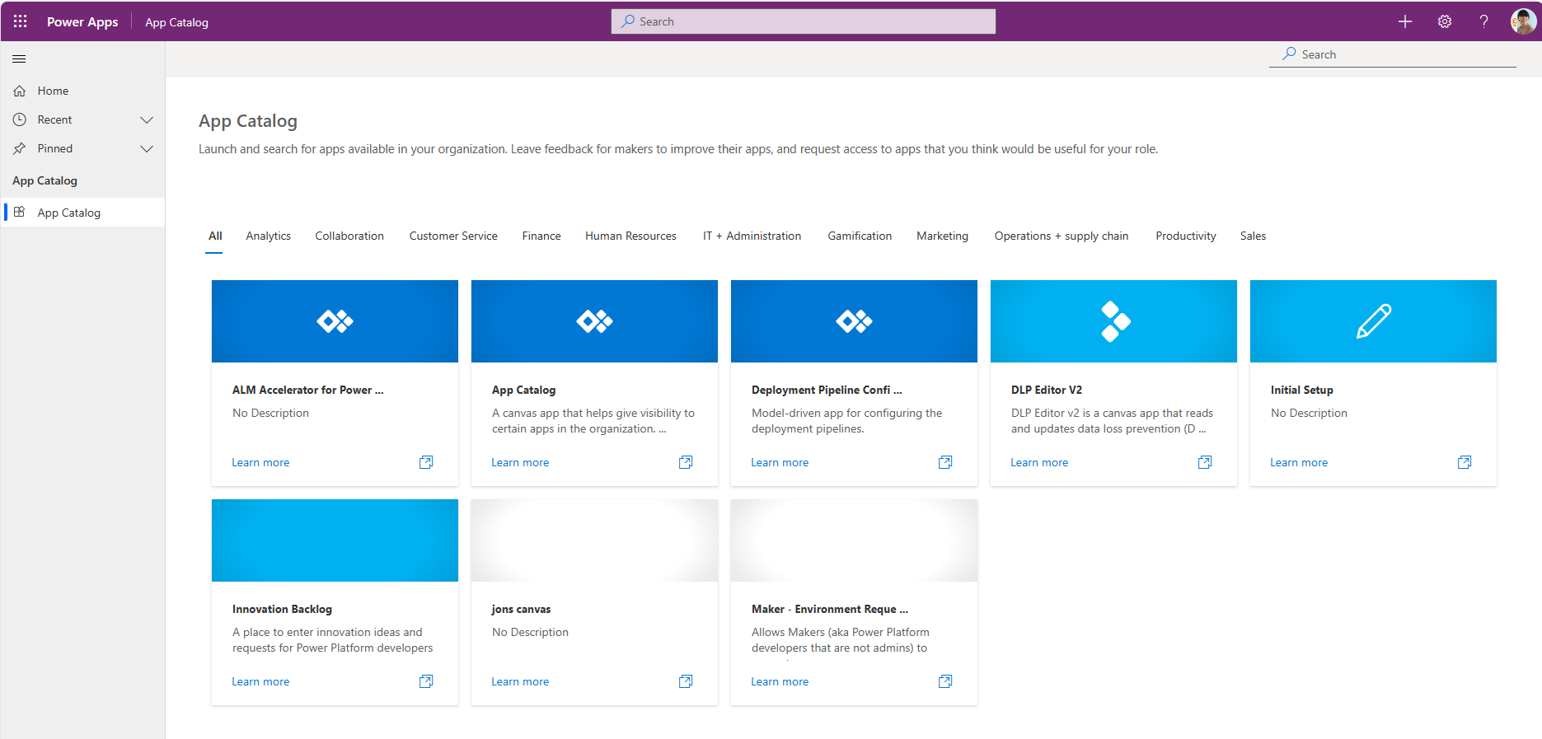
App catalog
Anne
Anne has access to a variety of apps that her colleagues have shared with her – but she’d like to explore what other apps are available at Contoso. Maybe one exists that already meets her needs?
Everyone

Slide 23
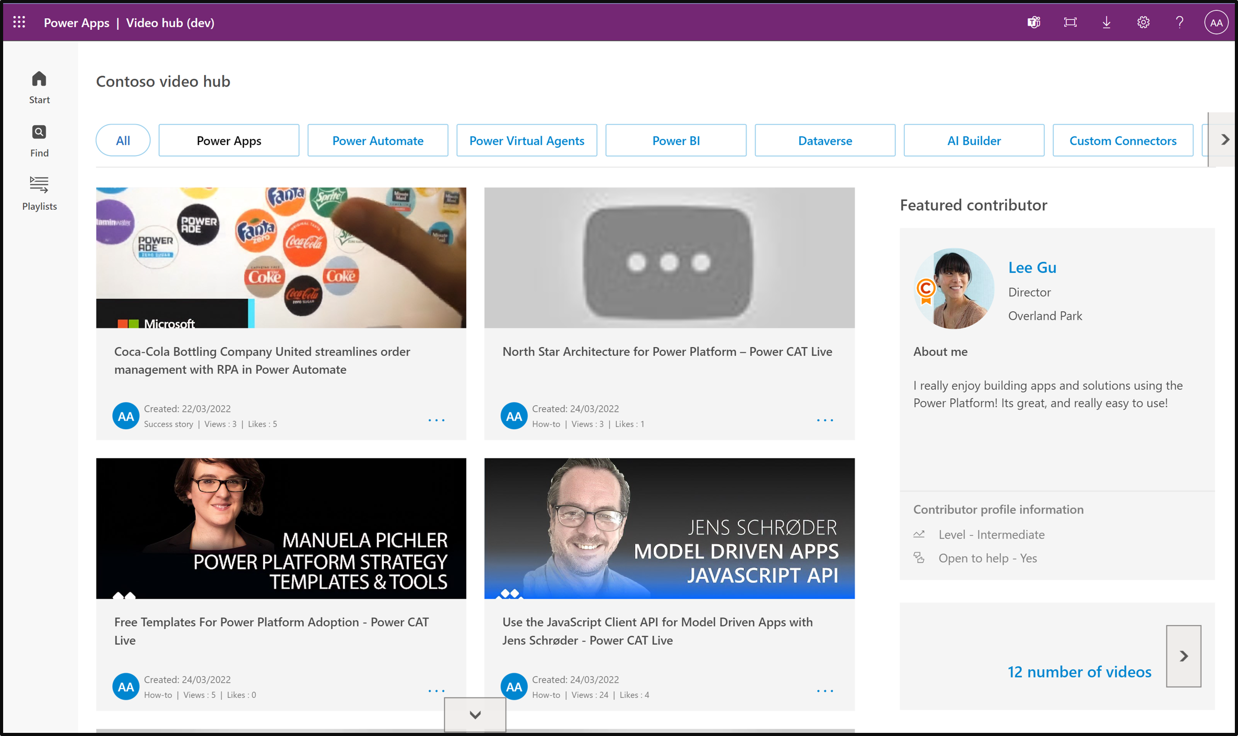
Innovation Backlog
App catalog
Video hub
Anne
Anne is finally ready to start her journey to become a maker herself – but there’s so much information out there, what does she have to learn first? The Video hub is a great place to start, and her Power Platform CoE team has put together helpful playlists to get her onboarding journey started.
Everyone

Slide 24
How to set up the CoE Starter Kit?
Prerequisites:
Power Platform environment with Dataverse capacity
Microsoft Power Platform service admin
Power Apps Per User license, Microsoft 365 license and Power Automate Per User or Per Flow license
Then:
Create your environment
Import the solution
Launch the CoE Setup Wizard app
https://aka.ms/coestarterkit

Slide 25
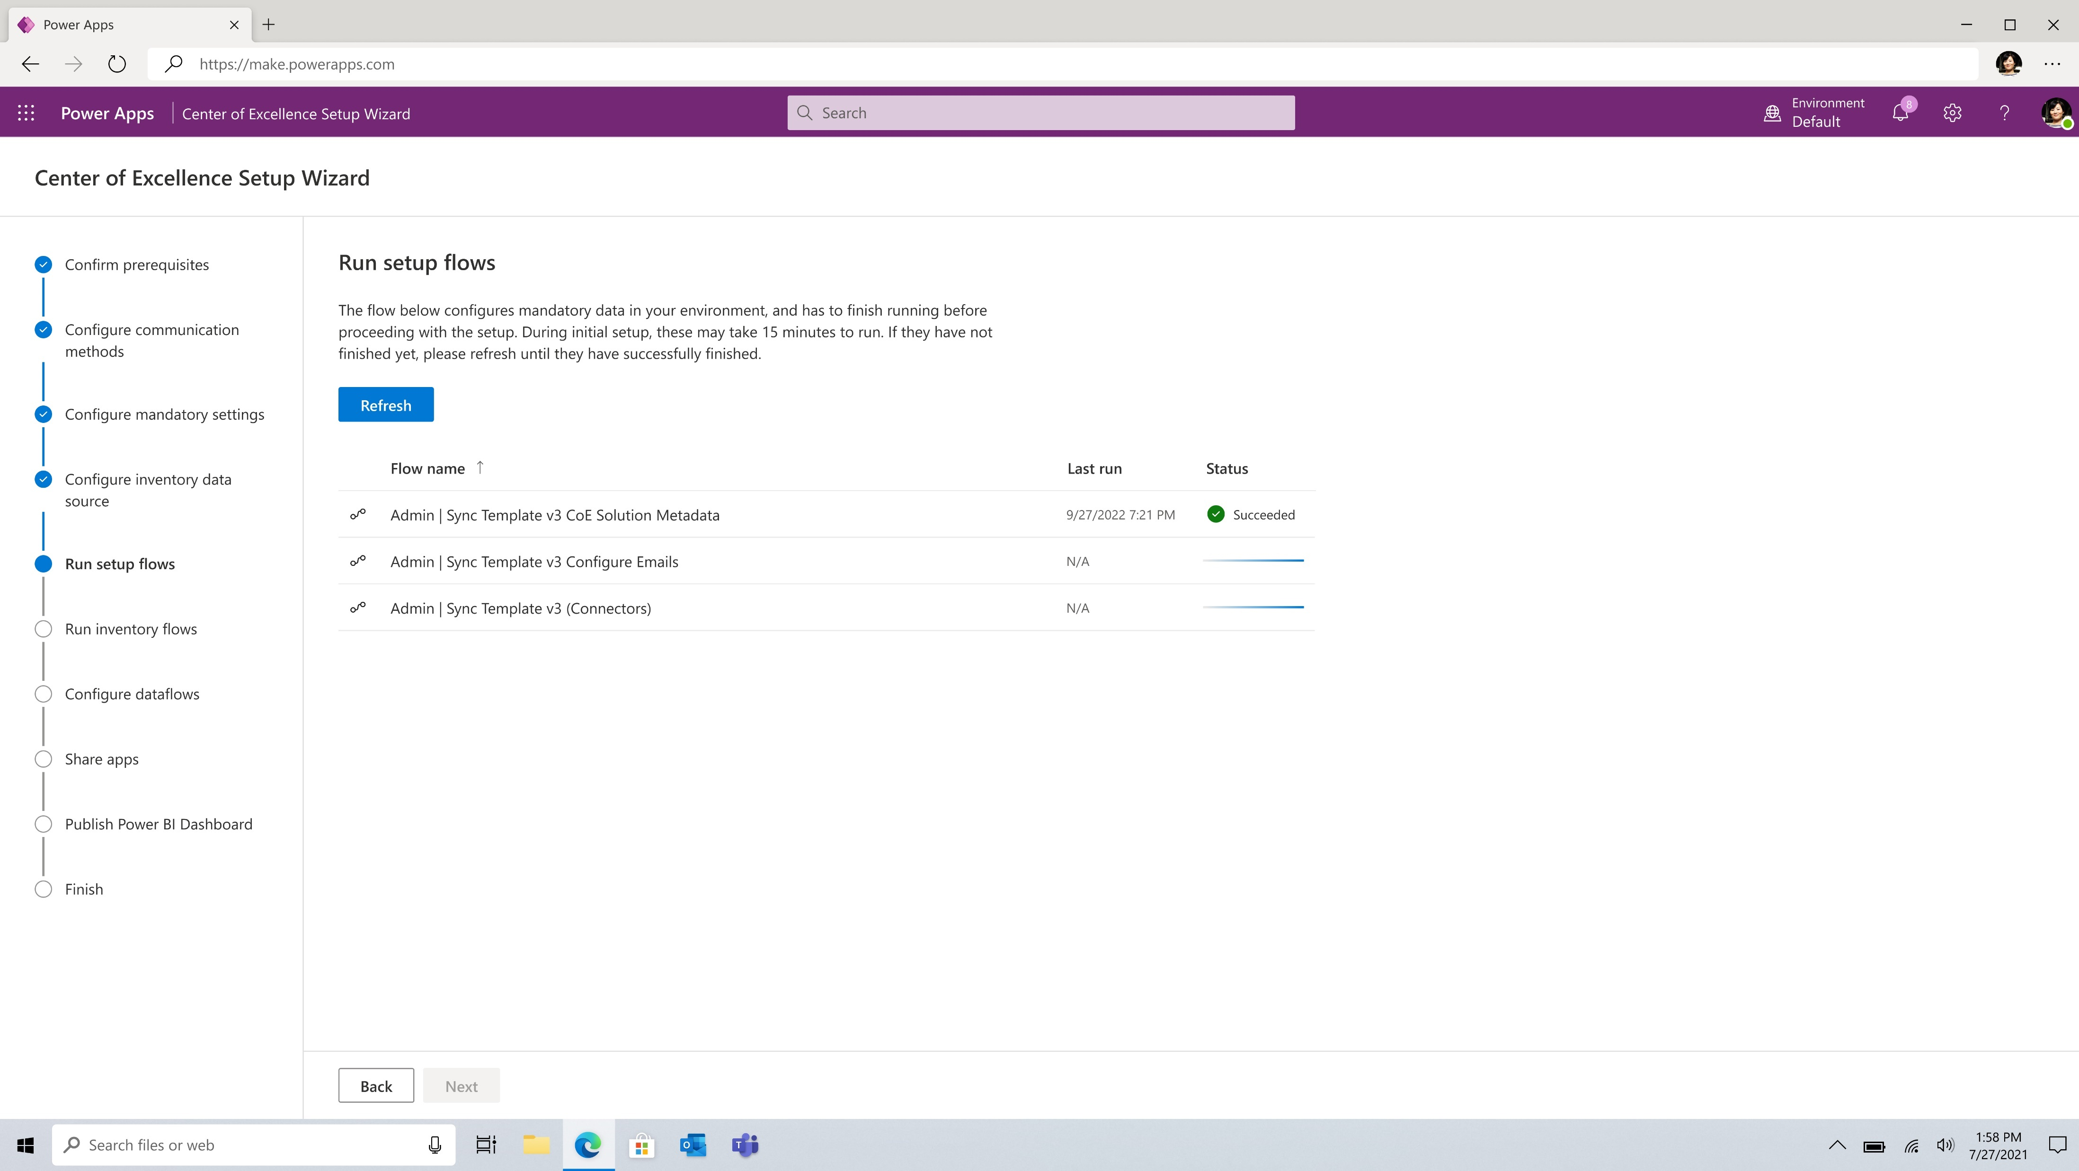
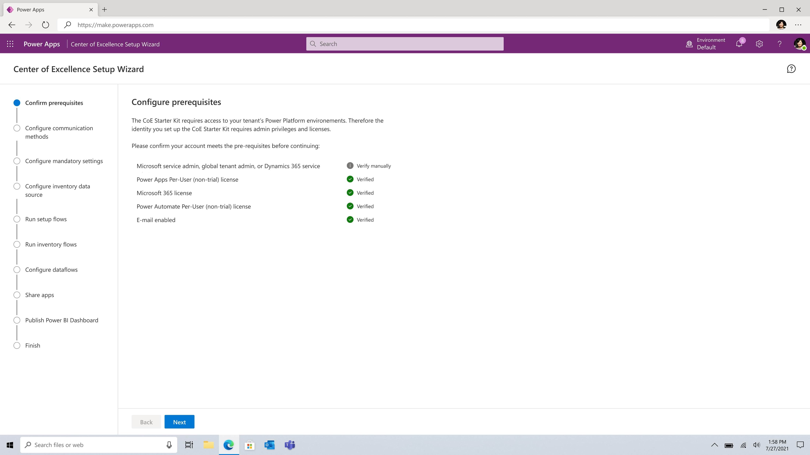
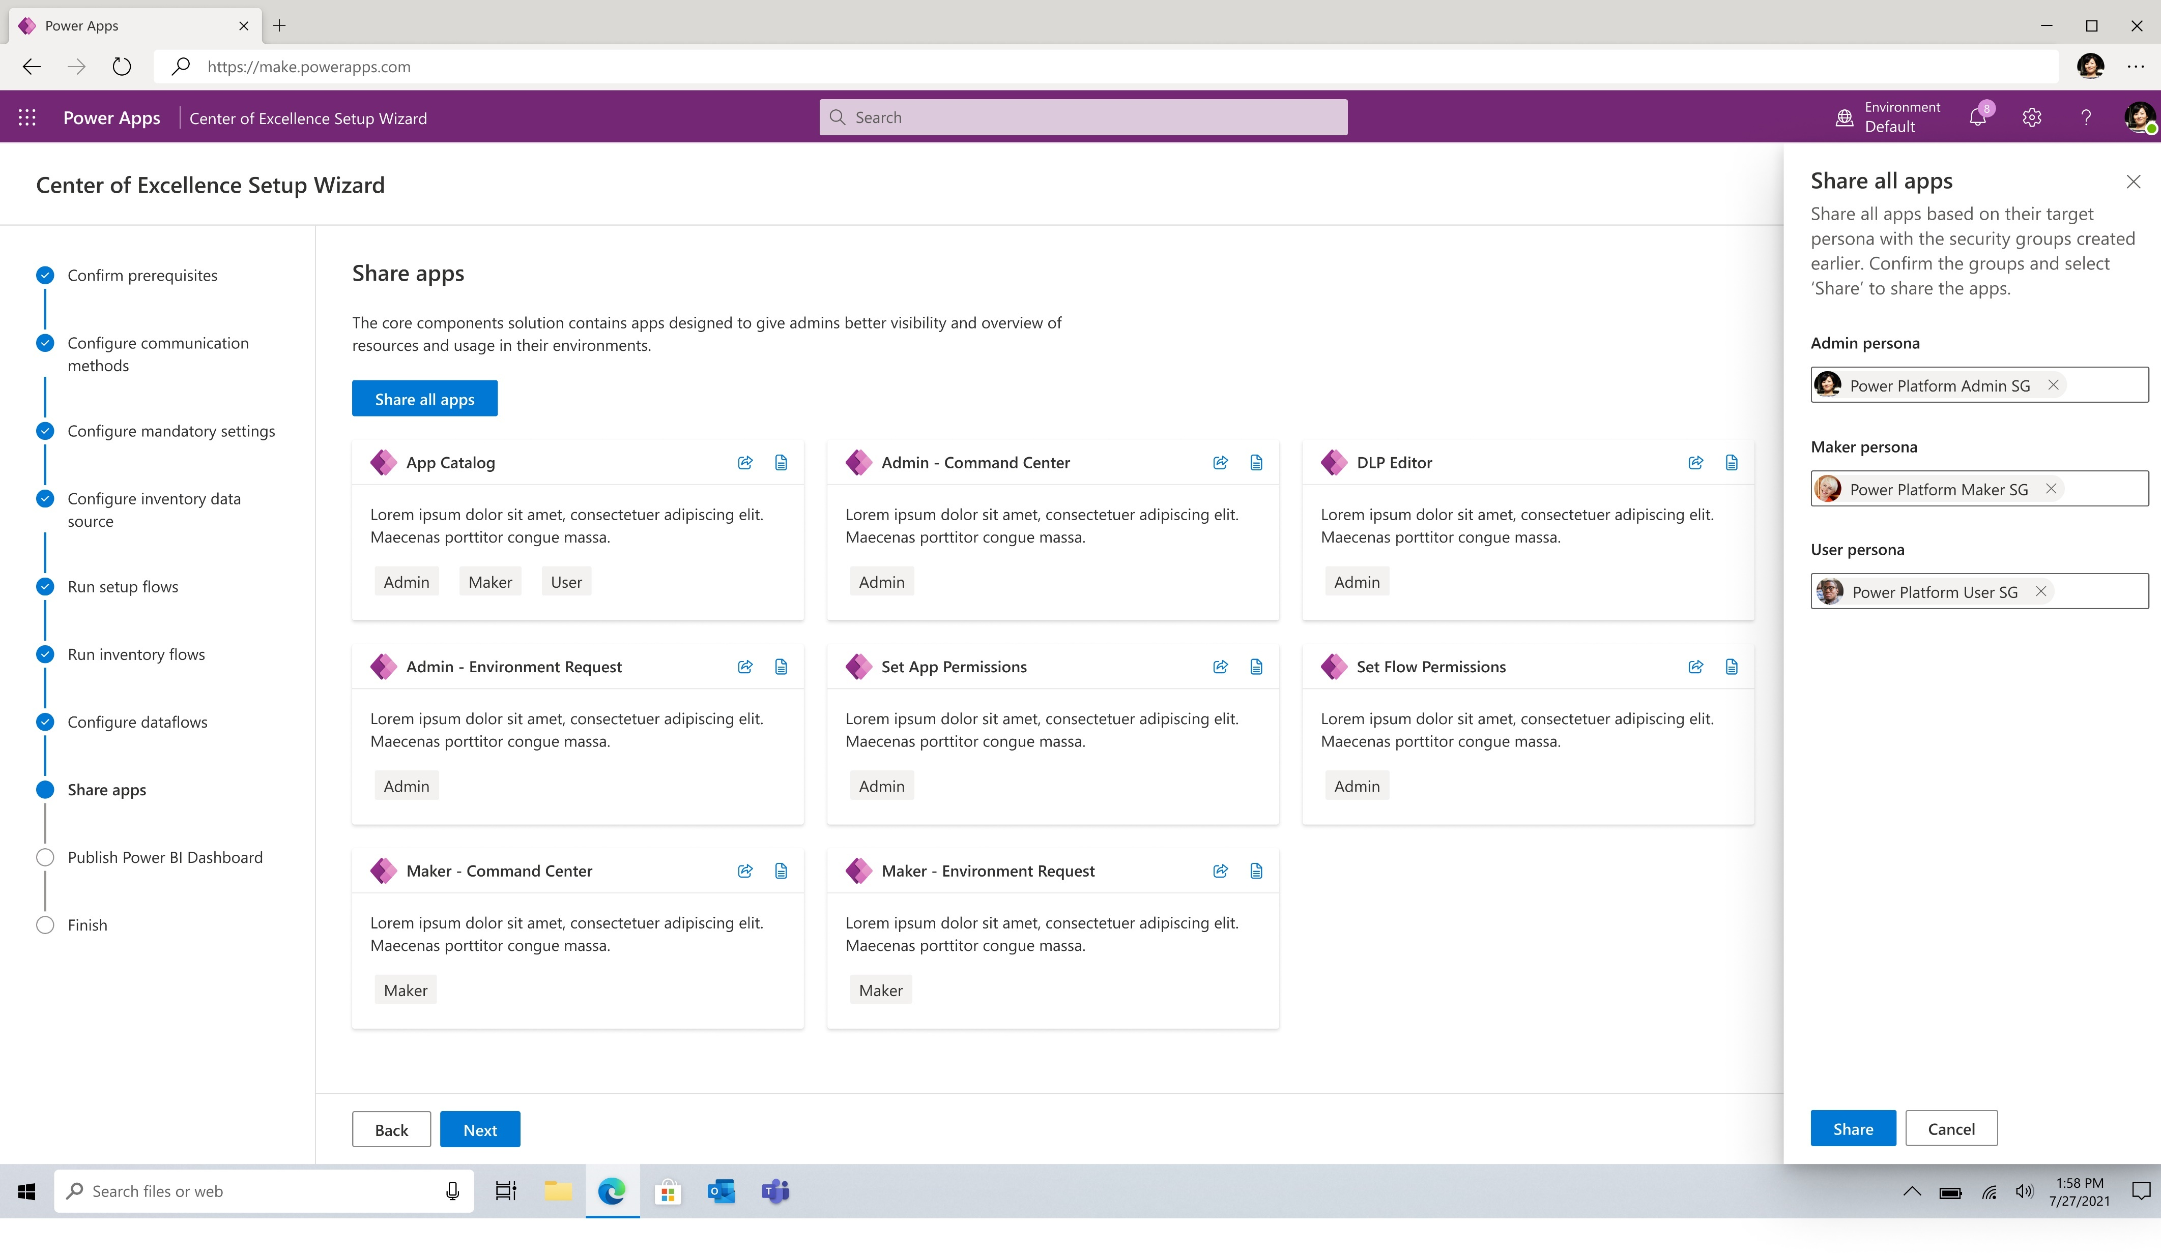
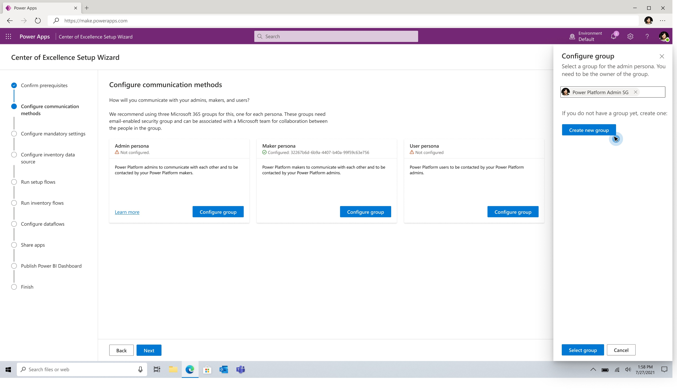
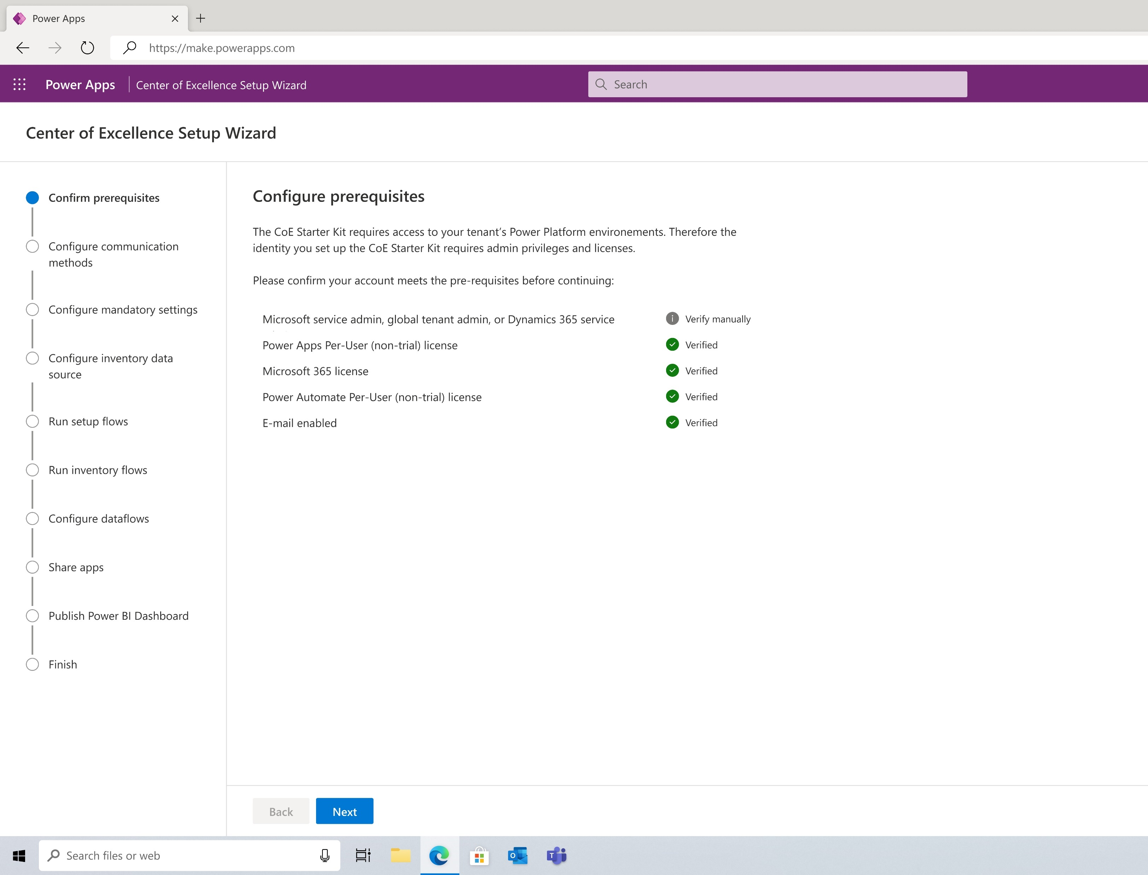
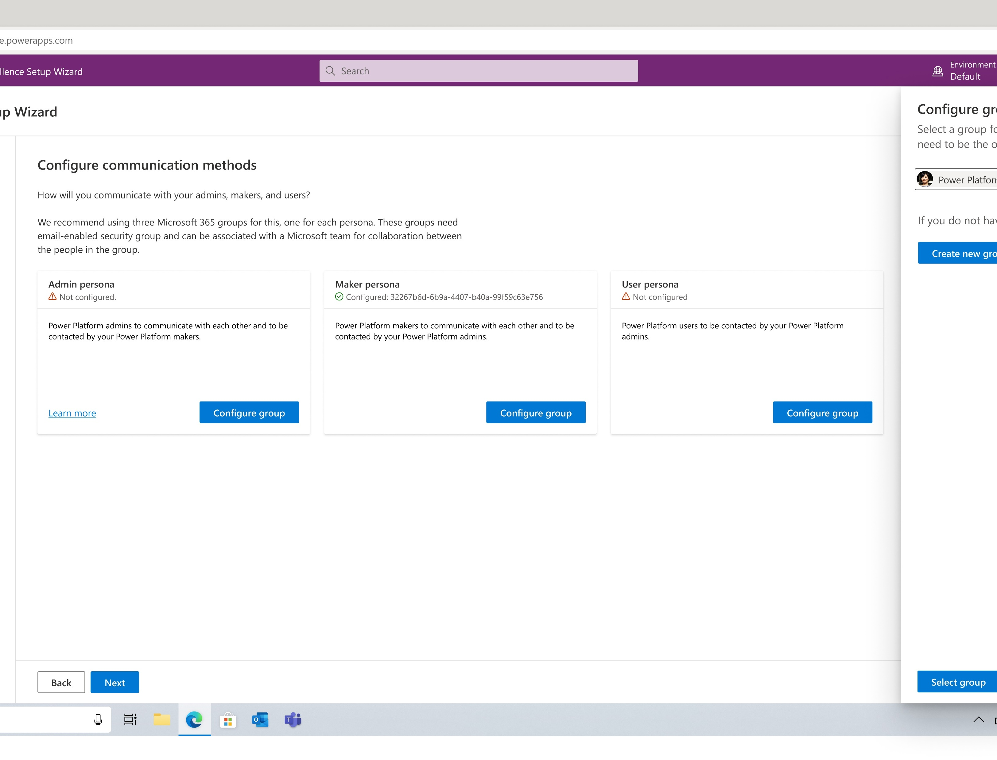
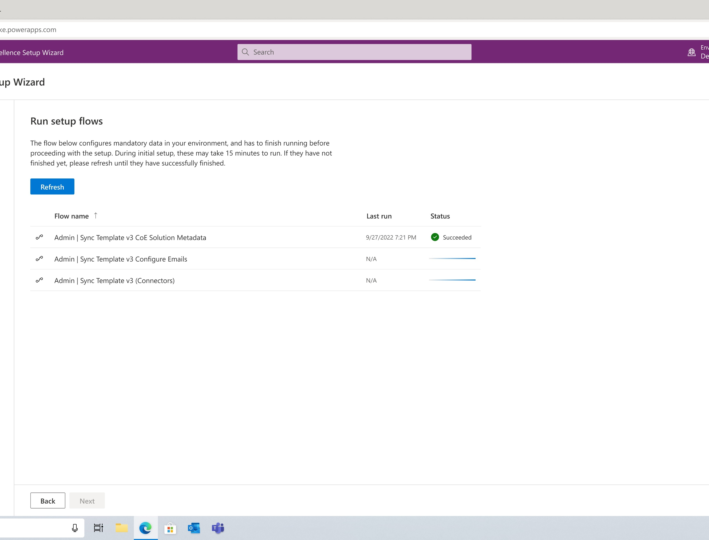
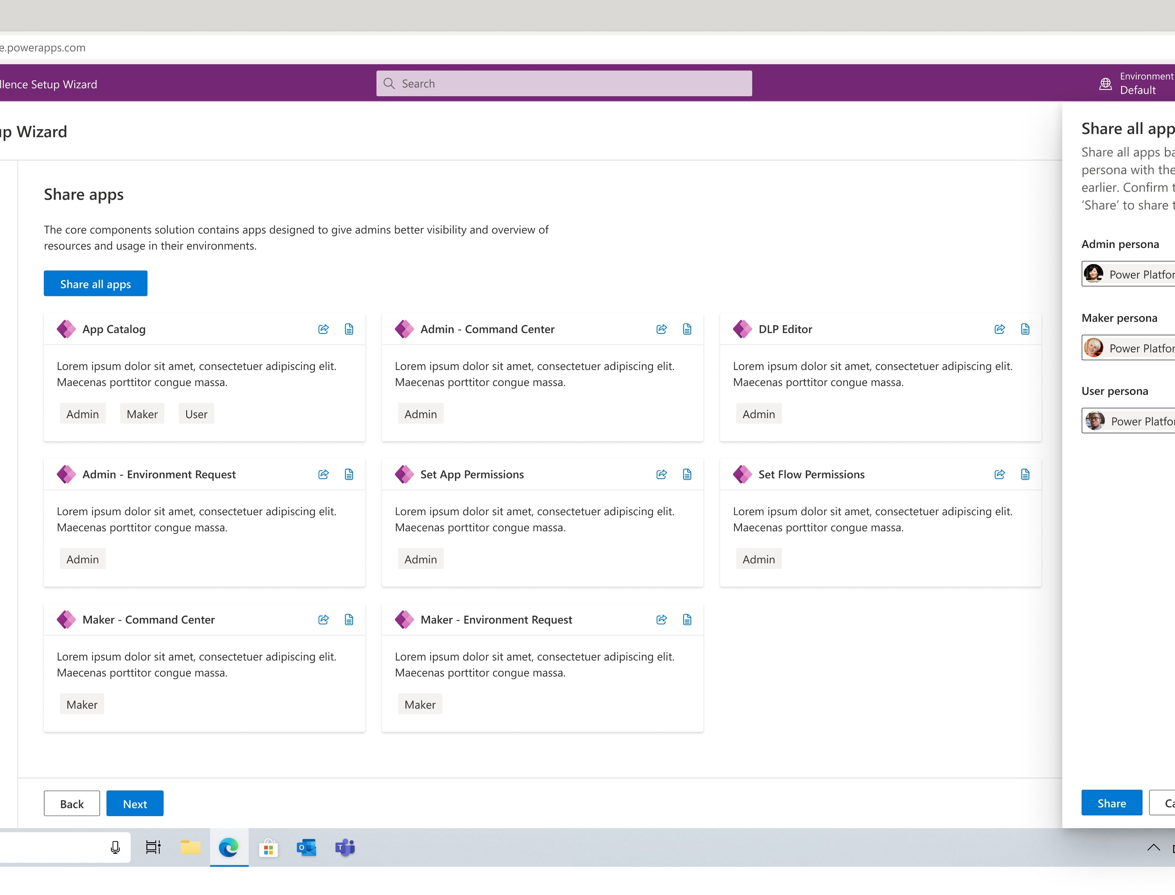




Setup - configuration
Coming soon
Check pre-requisites
Configure communication methods
Run flows
Share apps

Slide 26
How to extend the CoE Starter Kit
There are many reasons for why you may want to extend the CoE Starter Kit:
Capturing additional metadata for apps and flows—for example, as part of the Compliance process.
Modifying the apps and flows to fit existing processes you may have in place—for example, asking makers to provide additional information in the Developer Compliance Center.
Customizing the apps to fit with your organization's brand and theme, especially for broadly used apps like the App Catalog.
Building additional apps and flows on top of the inventory gathered by the CoE Starter Kit.
Create your own unmanaged solution for any extensions and customizations.
Use Dev-Test-Prod environments to move your changes to production.

Slide 27



How to extend the CoE Starter Kit
Tables and model-driven apps support merging. These resources can easily be extended by creating your own unmanaged solution and making changes there.
Canvas apps and cloud flows do not support merging. These resources can only be extended and customized by creating a copy in your own unmanaged solution.
Cloud flows that are responsible for gathering inventory should not be customized. These flows are frequently updated to fix bugs, gather additional data, or improve performance.
Power BI dashboards also don’t support merging. Create your own Power BI dashboard based of our data and publish it to the same Power BI workspace for a good user experience.

Slide 28
What’s the future of the CoE Starter Kit?
Customer feedback
Innovation
Experimentation
Inspire
Meet the unaddressed customer asks to help with Power Platform administration, governance, and nurture activities.
Join our office hours https://aka.ms/coeofficehours
Innovate using low-code in an open-source model together with customers.
Learn and adapt quickly with monthly releases.
Experiment to get deeper insights into what works, what doesn’t work, what’s next. Iterate on ideas quickly to try them out.
Continue to inspire the product roadmap.

Slide 29
Now you know what’s in the kit: what’s next?
Get started
Get connected
Check out https://aka.ms/coekitvideos
Get familiar with our documentation and prerequisites https://aka.ms/coestarterkit
Set up and configure the Core components solution!
Join our monthly office hours to raise questions and provide feedback
https://aka.ms/coeofficehours
Share your ideas in our GitHub repo https://aka.ms/coestarterkitrepo

